Slide 1
CS188: Distributed Systems Lecture 2
Spring 2019
Ravi Netravali

Slide 2
Today’s agenda
MapReduce
Overview
Fault tolerance needs/challenges
Intro to Assignment 1
Replicated State Machine
Overview
Synchronization challenges

Slide 3

MapReduce scenario
Genomics/biotech company that generates personalized DNA report (for ancestry analyses)
Collect genome data from roughly one million users
125 MB of data per user
Goal: analyze data to identify genes that show susceptibility to Parkinson’s disease

Slide 4



Other MapReduce scenarios
Ranking web pages for search
Requires analyzing 100 billion web pages
Selecting ads for different users
Requires analyzing clicks/actions for 1 billion users
Real-time system diagnostics
Requires analysis of data transactions and system logs, 7TB/month

Slide 5
Lots of data!
Petabytes (and soon, exabytes) of data
Cannot simply use one server
Impossible to store data on one server
Processing will take forever on one server
Need distributed storage and processing

Slide 6
Desirable properties for distributed processing
Scalable
Performance grows with number of machines
Fault tolerant
Can make progress despite machine failures
Simple
Low programmer expertise required
Widely applicable and flexible
Impose minimal restrictions on type of processing feasible

Slide 7
Distributed data processing
Strawman solution
Partition data across many servers
Each server processes local data
Issue: may need to analyze entire dataset due to inter-data dependencies
PageRank: depends on ranking of all pages that link to it
23andme: need data from all users with a certain gene to evaluate susceptibility to a disease
Why won’t this work?

Slide 8

MapReduce
Distributed data processing paradigm
Introduced by Google in 2004
Popularized by open-source Hadoop framework
MapReduce represents two things
Programming interface for data processing jobs: Map and Reduce functions
Distributed execution framework: Scalable and fault-tolerant

Slide 9
MapReduce execution
Partition
Map
Coalesce
Reduce
(k₁, v₁)
.
.
(a, b)
(w, p)
(a, b)
(a, q)
(a, s)
(k₁, v₁)
(k₂, v₂)
.
.
.
.
.
.
.
(k_{n}, v_{n})
(k¹, v¹)
(w, x)
(y, r)
(c, d)
(k_{i}, v_{i})
.
.
(c, d)
(c, t)
(k², v²)
(w, p)
(w, x)
(y, z)
(a, s)
(c, t)
(a, q)
(k³, v³)
(k_{j}, v_{j})
.
.
(y, r)
(y, z)
(k⁴, v⁴)

Slide 10
MapReduce example: word count
map(key, value): // filename, file contents
for each word w in value:
EmitIntermediate(w, “1”);
reduce(key, list(values)): // word, counts
int result = 0;
for each v in values:
result += ParseInt(v);
Emit(AsString(result));
Given file name and contents, output key/value pair for each instance of every word in file, e.g., (word, 1)
Runs on all key/value pairs that pertain to each word, and sum all values as word count

Slide 11
MapReduce example: PageRank
Goal: compute rank for page P as average rank of pages that link to P
Assume initial rank values for each page based on previous analyses
Map(a web page W, W’s contents)
For every web page P that W links to, output (P, W)
Reduce(web page P, {set of all pages that link to P})
Output rank for P as average rank of pages that link to P
Run repeatedly until ranks converge

Slide 12
MapReduce execution continued
Partition
Map
Coalesce
Reduce
(k₁, v₁)
.
.
(a, b)
(w, p)
(a, b)
(a, q)
(a, s)
(k₁, v₁)
(k₂, v₂)
.
.
.
.
.
.
.
(k_{n}, v_{n})
(k¹, v¹)
(w, x)
(y, r)
(c, d)
(k_{i}, v_{i})
.
.
(c, d)
(c, t)
(k², v²)
(w, p)
(w, x)
(y, z)
(a, s)
(c, t)
(a, q)
(k³, v³)
When can a reduce task begin executing?
(k_{j}, v_{j})
.
.
(y, r)
(y, z)
(k⁴, v⁴)

Slide 13
Synchronization barrier
Partition
Map
Coalesce
Reduce
Can’t run reduce task until all map tasks finish (ensures that all values for a given key are ready)
(k₁, v₁)
.
.
(a, b)
(w, p)
(a, b)
(a, q)
(a, s)
(k₁, v₁)
(k₂, v₂)
.
.
.
.
.
.
.
(k_{n}, v_{n})
(k¹, v¹)
(w, x)
(y, r)
(c, d)
(k_{i}, v_{i})
.
.
(c, d)
(c, t)
(k², v²)
(w, p)
(w, x)
(y, z)
(a, s)
(c, t)
(a, q)
(k³, v³)
X
Any failure will prevent reduce stage from starting
(k_{j}, v_{j})
.
.
(y, r)
(y, z)
(k⁴, v⁴)

Slide 14
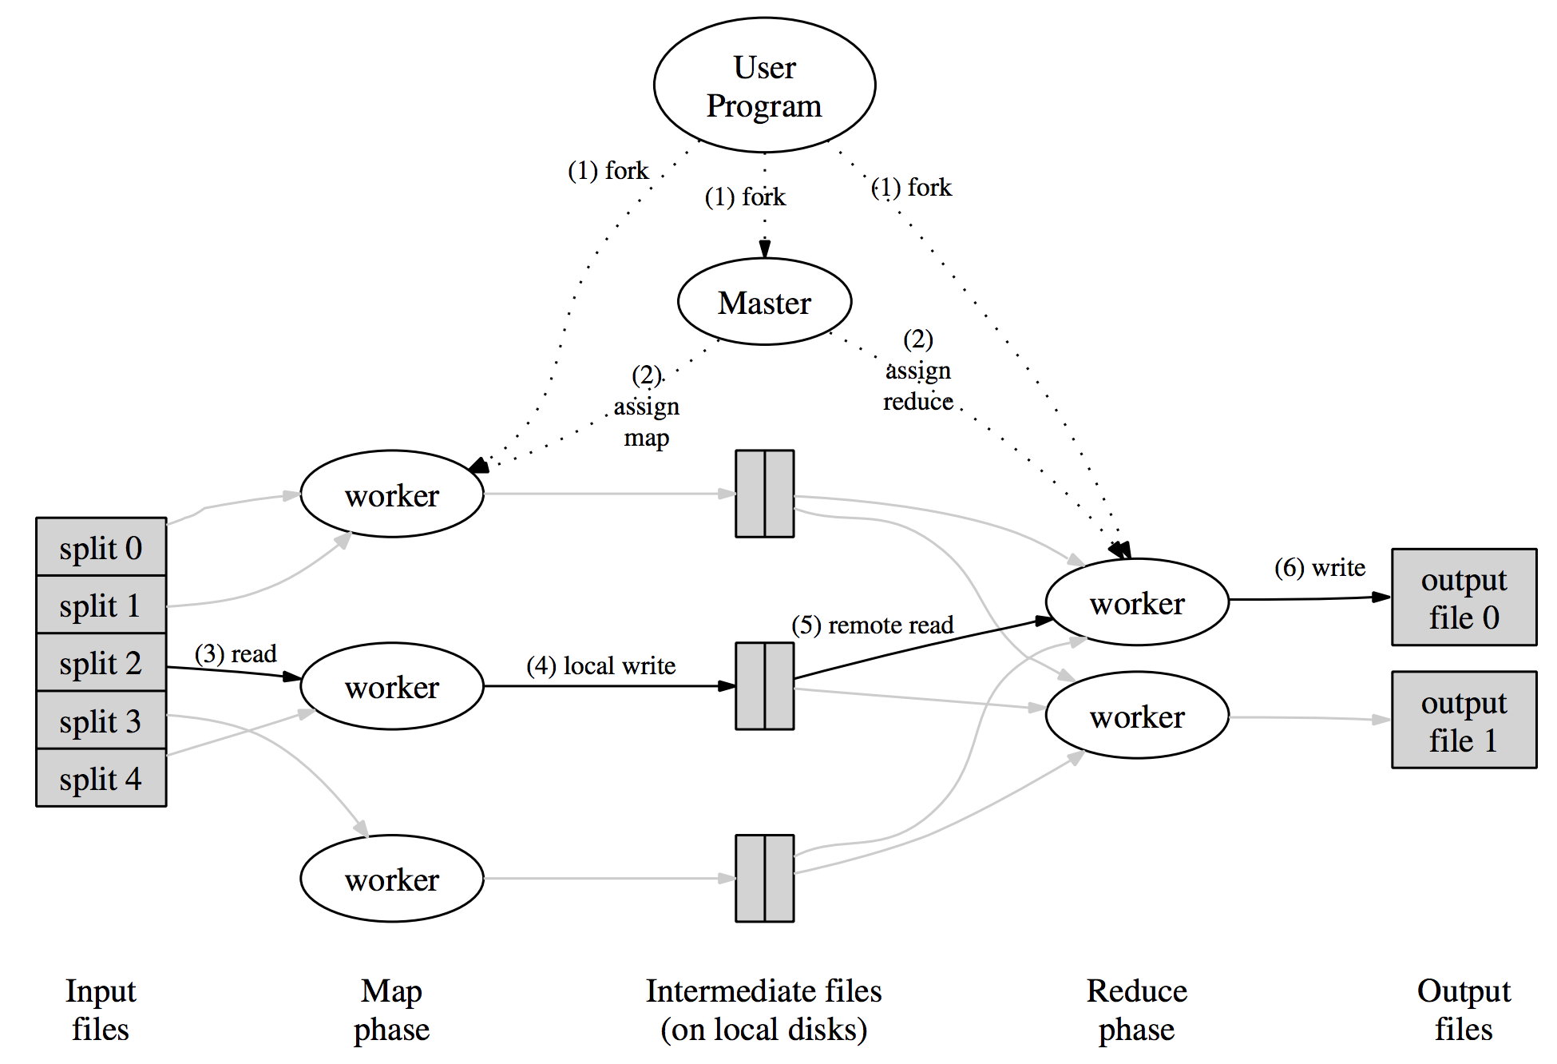
Fault tolerance via master node
Master responsibilities for fault tolerance:
Assign map/reduce jobs to workers
Keep track of status of tasks
Keep track of machine failures (rerun tasks as necessary)

Slide 15
Assignment 1
Part 1: write map and reduce functions for word count
Key goal is to get familiar with Go
Parts 2-3: implement central master
Part 2: given sequential executor of map/reduce functions, enable distributed execution
Part 3: modify master to deal with failures (network or worker)
Goal: reason about failures
Reminders:
Look for partners for next assignments
Discussion Friday: Go tutorial

Slide 16
Handling master failures
If master node fails, can we start new master and resume execution?
No!
Lost all state about task execution status (i.e., which tasks are finished, currently running (and by whom), and need to be run)
Need to start from scratch → wasted resources and time
Better solution: replicate master state to tolerate failures

Slide 17

Replicating MapReduce master
Task 3
assigned
to W1
Master M1
Map tasks:
1 2 3 4
Master M2
Map tasks:
1 2 3 4
Done with
task 1
Run
task 3
Run
task 3
Done with
task 2
Worker W1
Worker W2
Problem: what if W2 finishes task 2 before M1 tells M2 that W1 has been assigned task 3?

Slide 18
Replicating bank account information
“Deposit
$100”
Inconsistent replicas!
$1,000
$1,010
$1,000
$1,110
$1,100
$1,111
“Pay 1%
interest”

Slide 19
Synchronizing replicas
How can we ensure that replicas are in sync?
Apply updates in same order at all replicas
Model every replica as a state machine
Given identical initial states, applying updates in same order results in same final state
Replicated state machine: run copies of same state machine across many servers
Challenge: doing this efficiently!

Slide 20
Replicated state machine
Option 1: replicate over time
Start new replicate after one goes down
Assumes execution state from failed machine is available to continue from
Crash failures
Option 2: replicate over space
Run multiple replicas simultaneously
Assume that when something fails, all state is lost
Fail-stop failures

Slide 21
Implementing a replicated state machine
Approach: Given list of received updates, order them based on time of receipt
Challenge: clocks are not in sync across replicas
Multiple updates can arrive at different machines at different times → don’t want to pick order based on different clocks

Slide 22


Clock syncing: challenges
Leverage GPS broadcasts?
Time from GPS is accurate to about 1 microsecond
Problem: power hungry and does not work indoors
Correct skew based on a reference clock?
Problem: clock drift
Problem: unbounded network delay
Client
Server
Time of day?
2:50 PM
Network Time Protocol (NTP): sync clock with dedicated servers around the world
Time ↓

Slide 23
Christian’s algorithm
Client
Server
Client sends a request packet timestamped with its local clock at T₁
Server timestamps its receipt of the request at T₂ with its local clock
Server responds with response packet that contains current local clock T₃ and T₂
Client locally timestamps its receipt of server’s response at T₄
T₁
request:
T₁
T₂
T₃
T₄
T₂,T₃
response:
Time ↓
How can client use these timestamps to sync its local clock to the server’s clock?

Slide 24
Christian’s algorithm continued
Client
Server
Goal: at T₄, client sets clock ← T₃ + 𝛿_{resp}
But the client knows 𝛿, not 𝛿_{resp}
Client measures round trip time 𝛿 = 𝛿_{req} + 𝛿_{resp} = (T₄ – T₁) – (T₃ – T₂)
Current “solution”: assume 𝛿_{req} ≈ 𝛿_{resp}
Client sets clock ← T₃ + 0.5 𝛿
Another limitation: relies on availability of time server
T₁
request:
T₁
𝛿_{req}
T₂
𝛿_{resp}
T₃
T₄
T₂,T₃
response:
Time ↓

Slide 25
Next time…
Ordering events without synchronizing physical clocks

